Slide 1
Gather
Bornita Das, Jin Gyu Lee, Claudia Sinowato, Benjamin Teo

Slide 2
Problem / Goal
Foster a community of cooking enthusiasts
Provide users with a platform where they can:
search easily for recipes
get recommendations of recipes
meet new people using recipes

Slide 3
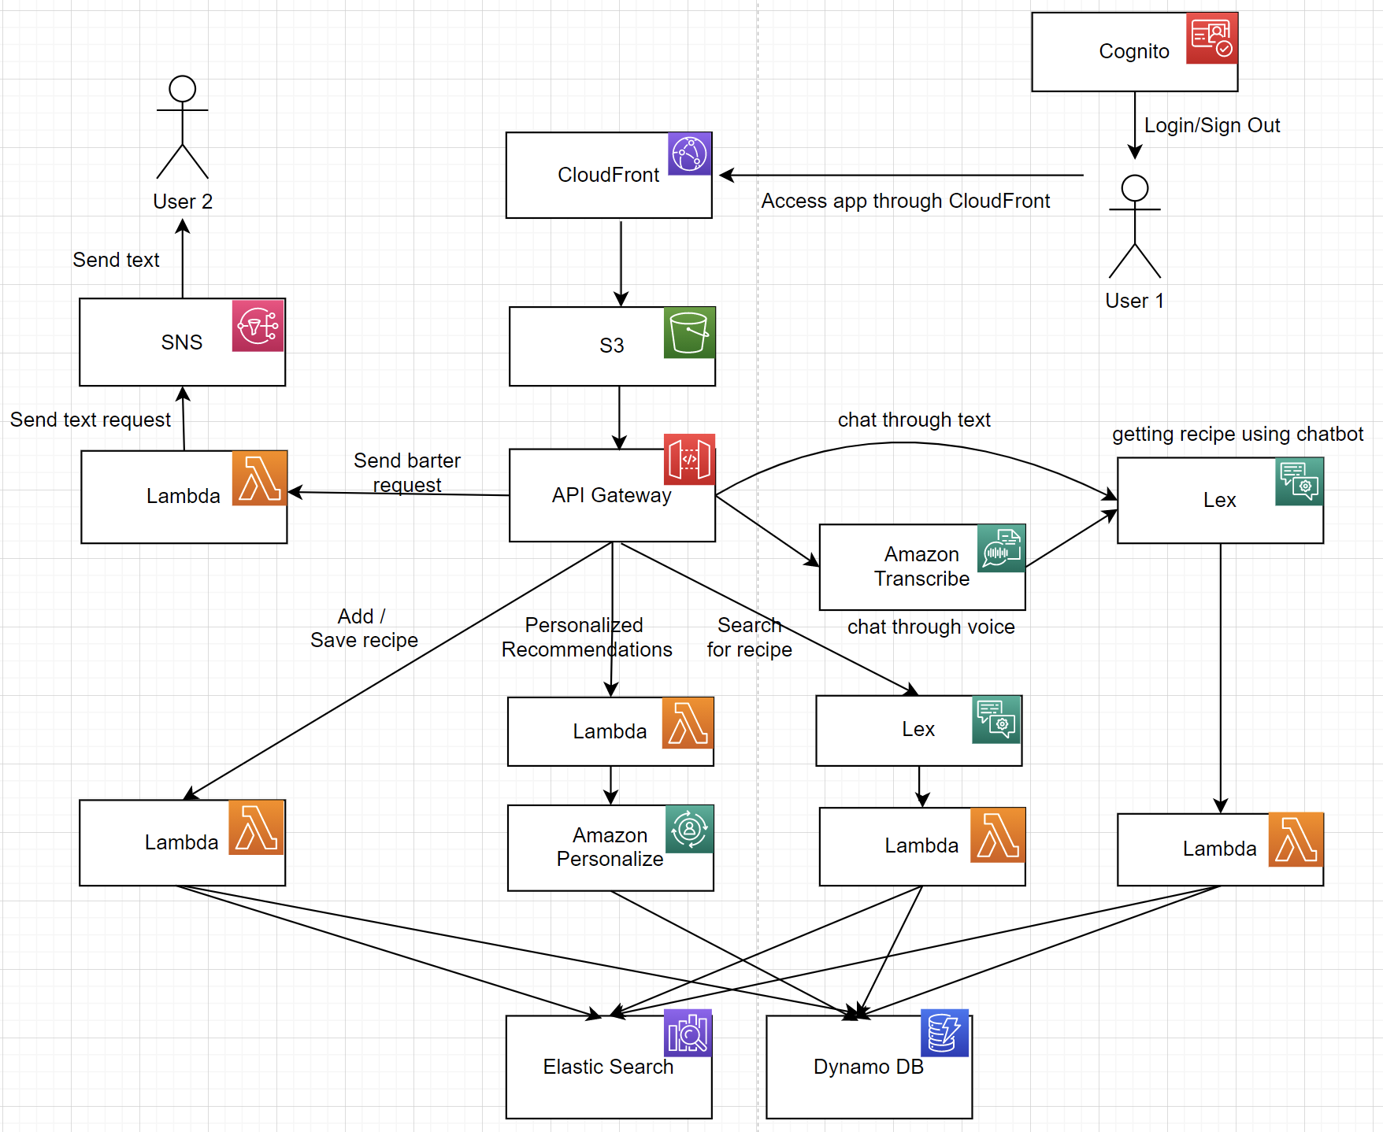
Architecture

Slide 4
API Implementation
Spoonacular
Data on thousands of recipes
Populate recipes database (recipe ids, names, ingredients, instructions, and images)
Train recommendation model
https://spoonacular.com/
Mapbox
Loads up the map for the city of New York
Markers on the address where bartered recipes are
Details of the recipes can be seen by clicking on the marker
https://www.mapbox.com/

Slide 5
Key Features
Search
Simple search
Chatbot search
Recipe Recommendations
Barter
Submit barter
Send request barter SMS

Slide 6
Thank you!

